Slide 1
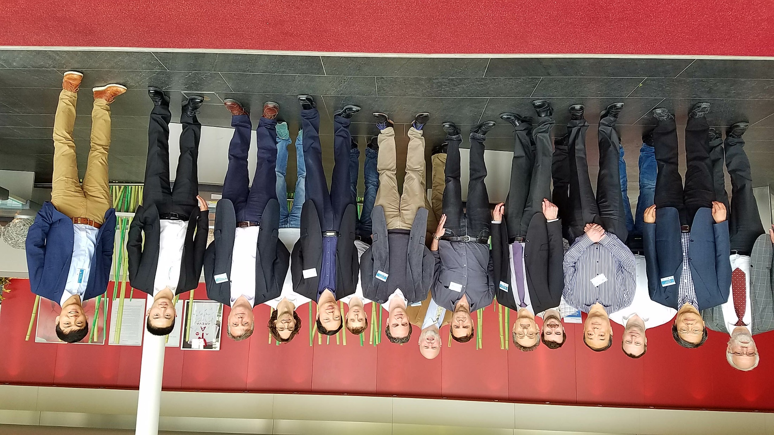
Second OECD/NEA C5G7-TD benchmark workshop

Slide 2
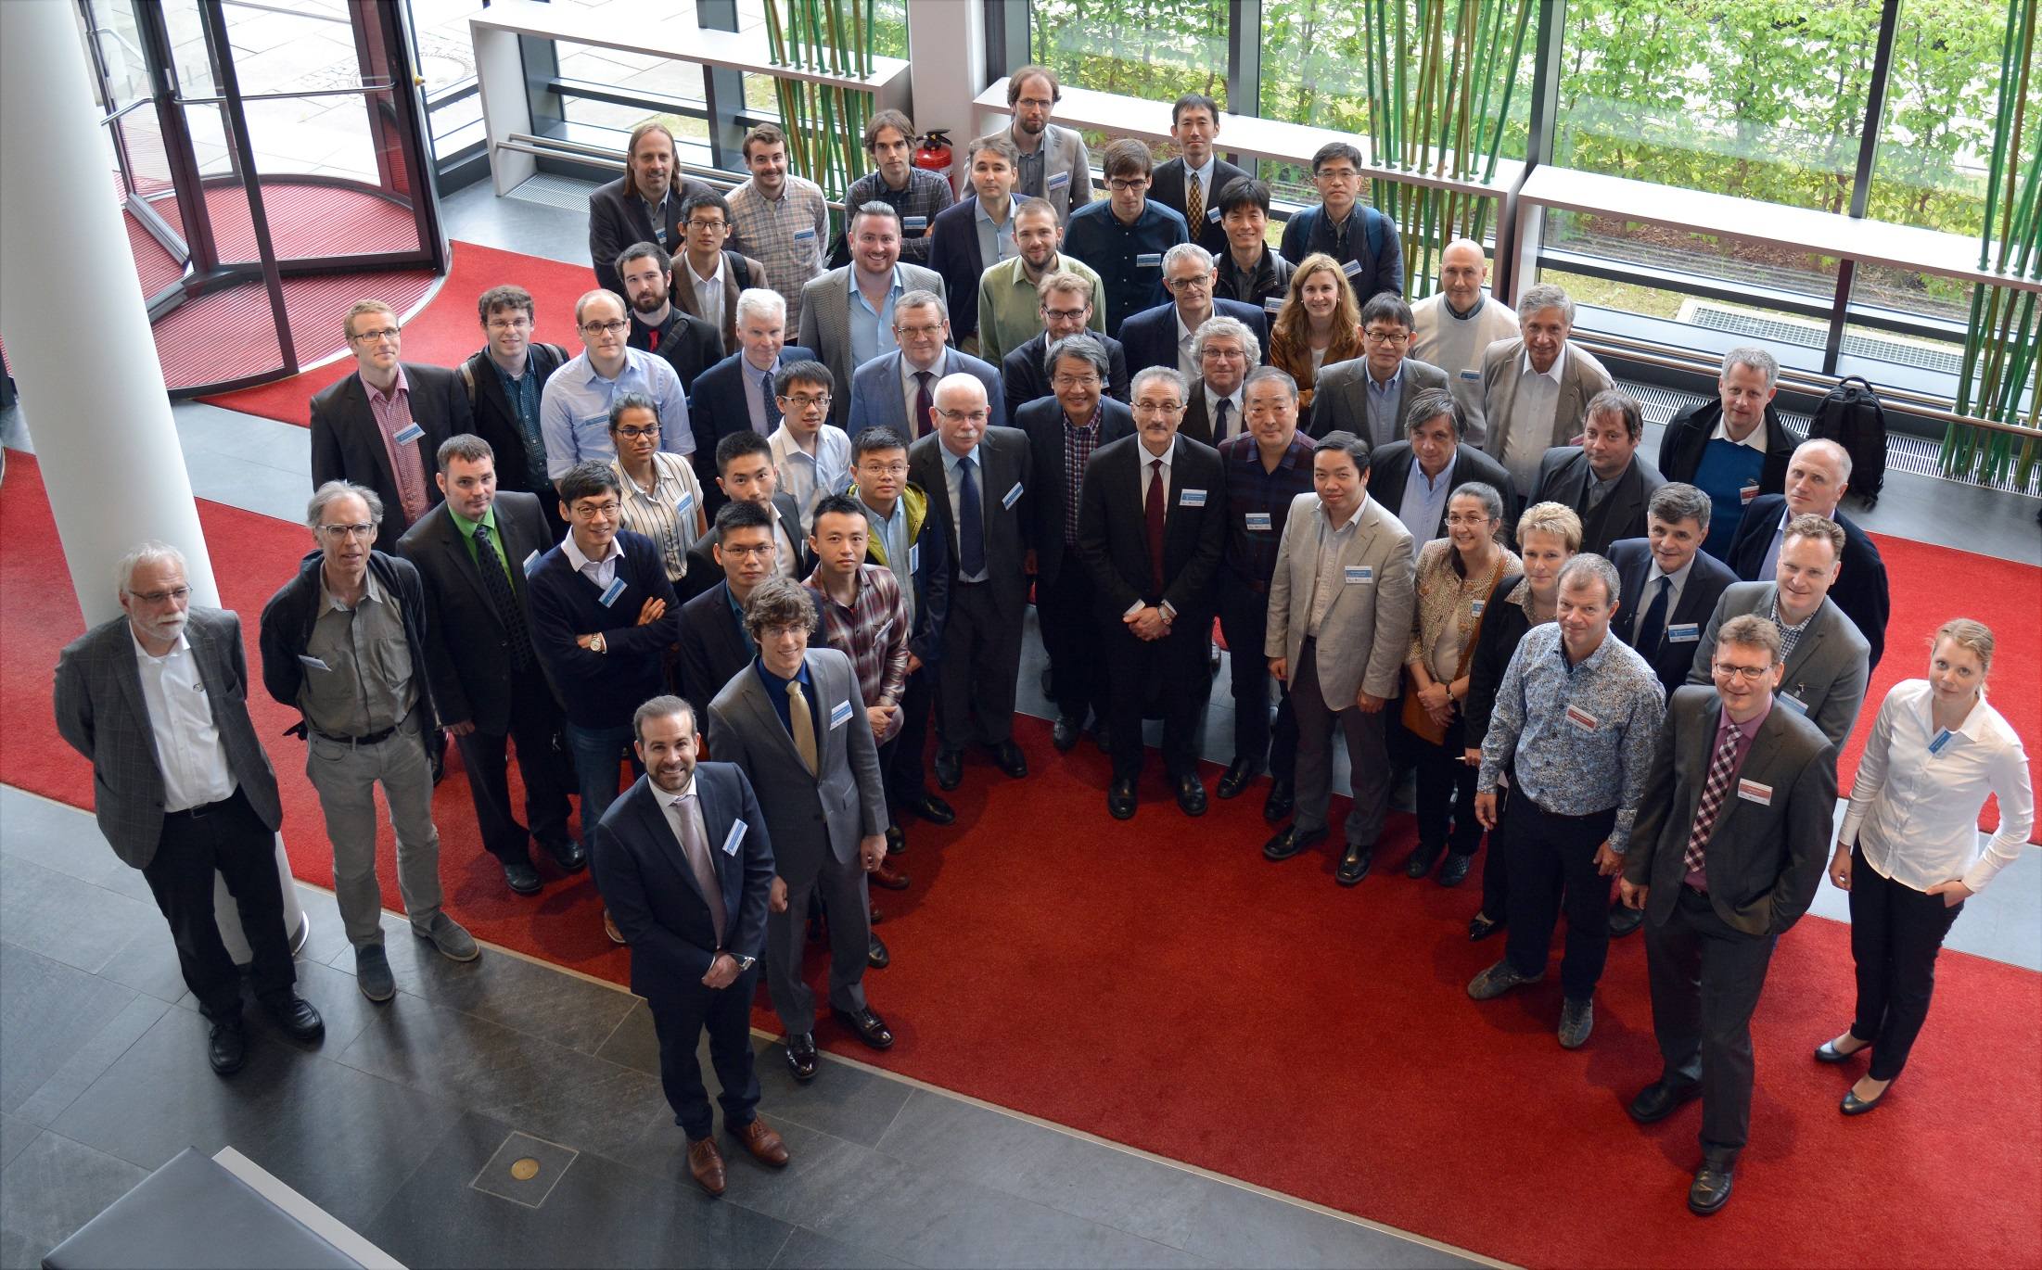
Working Party on Scientific Issues of Reactor Systems Workshops 2017
Monday May 8th

Slide 3
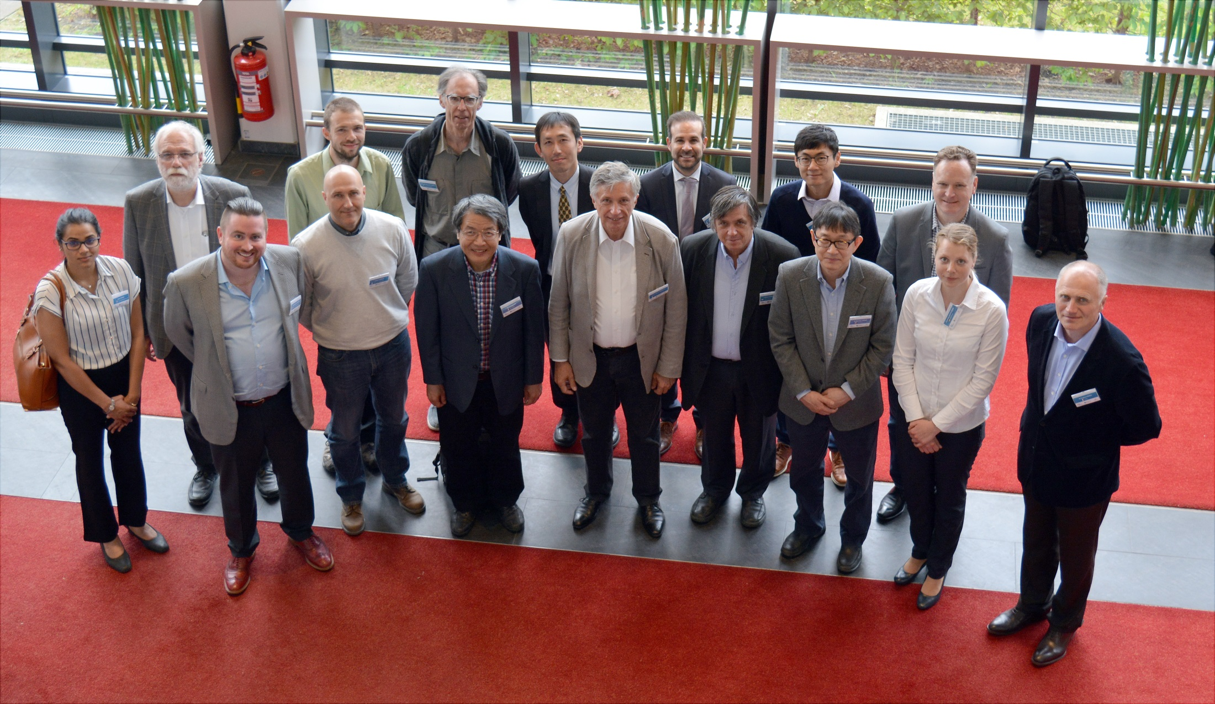
Third OECD/NEA Sodium Fast Reactor (SFR) Uncertainty Analysis in Modelling (UAM) benchmark workshop

Slide 4
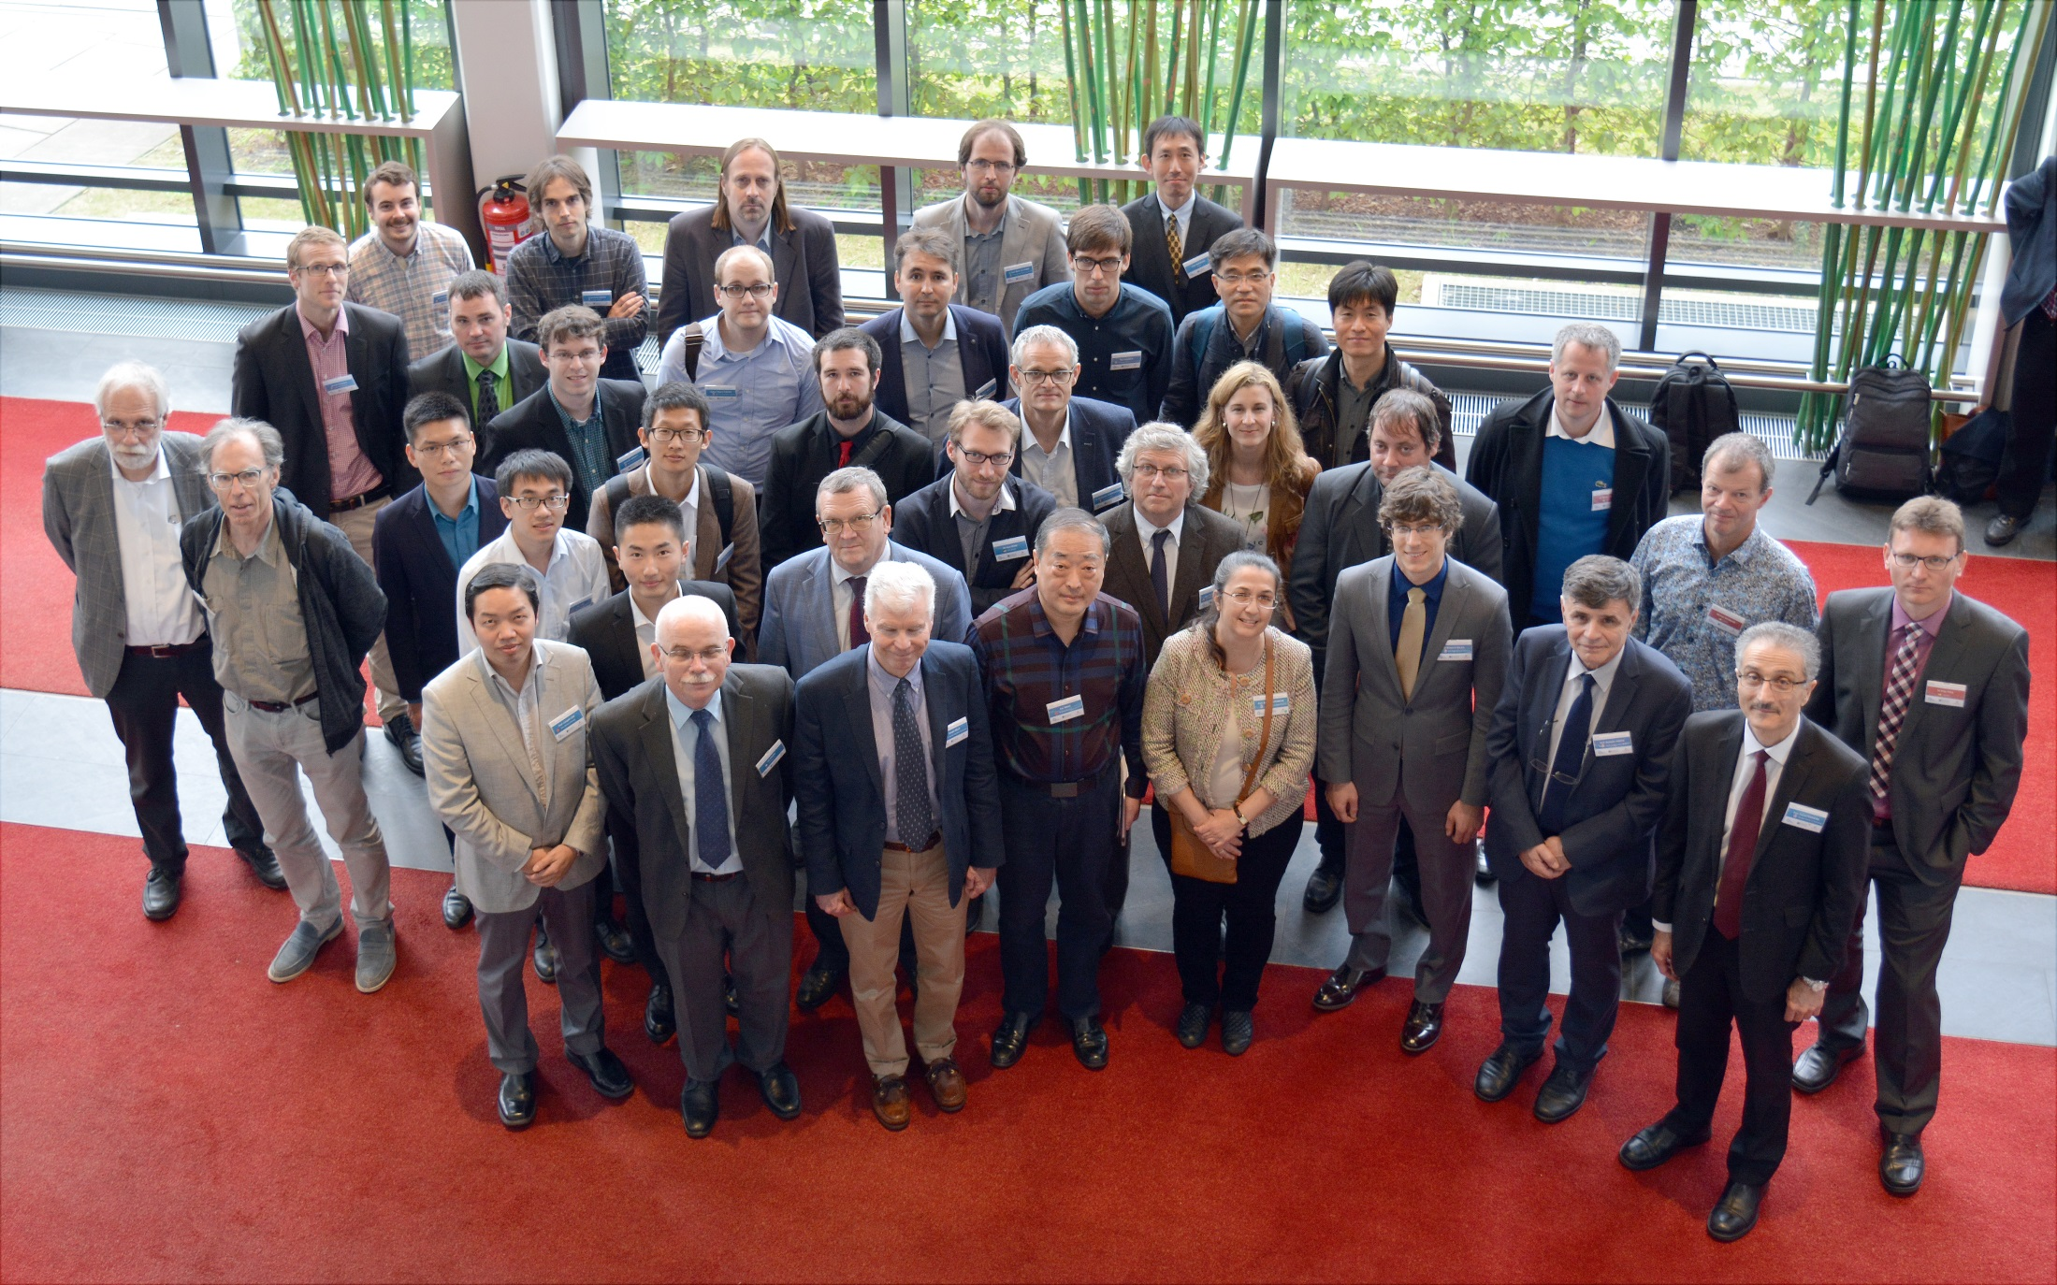
Fourth COBRA-TF (CTF) User’s Group Meeting (UGM)

Slide 5
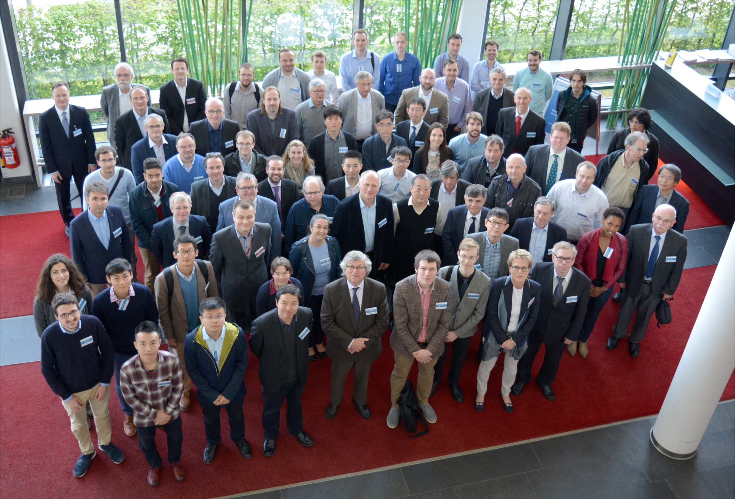
Working Party on Scientific Issues of Reactor Systems Workshops 2017
Wednesday May 10th

Slide 6
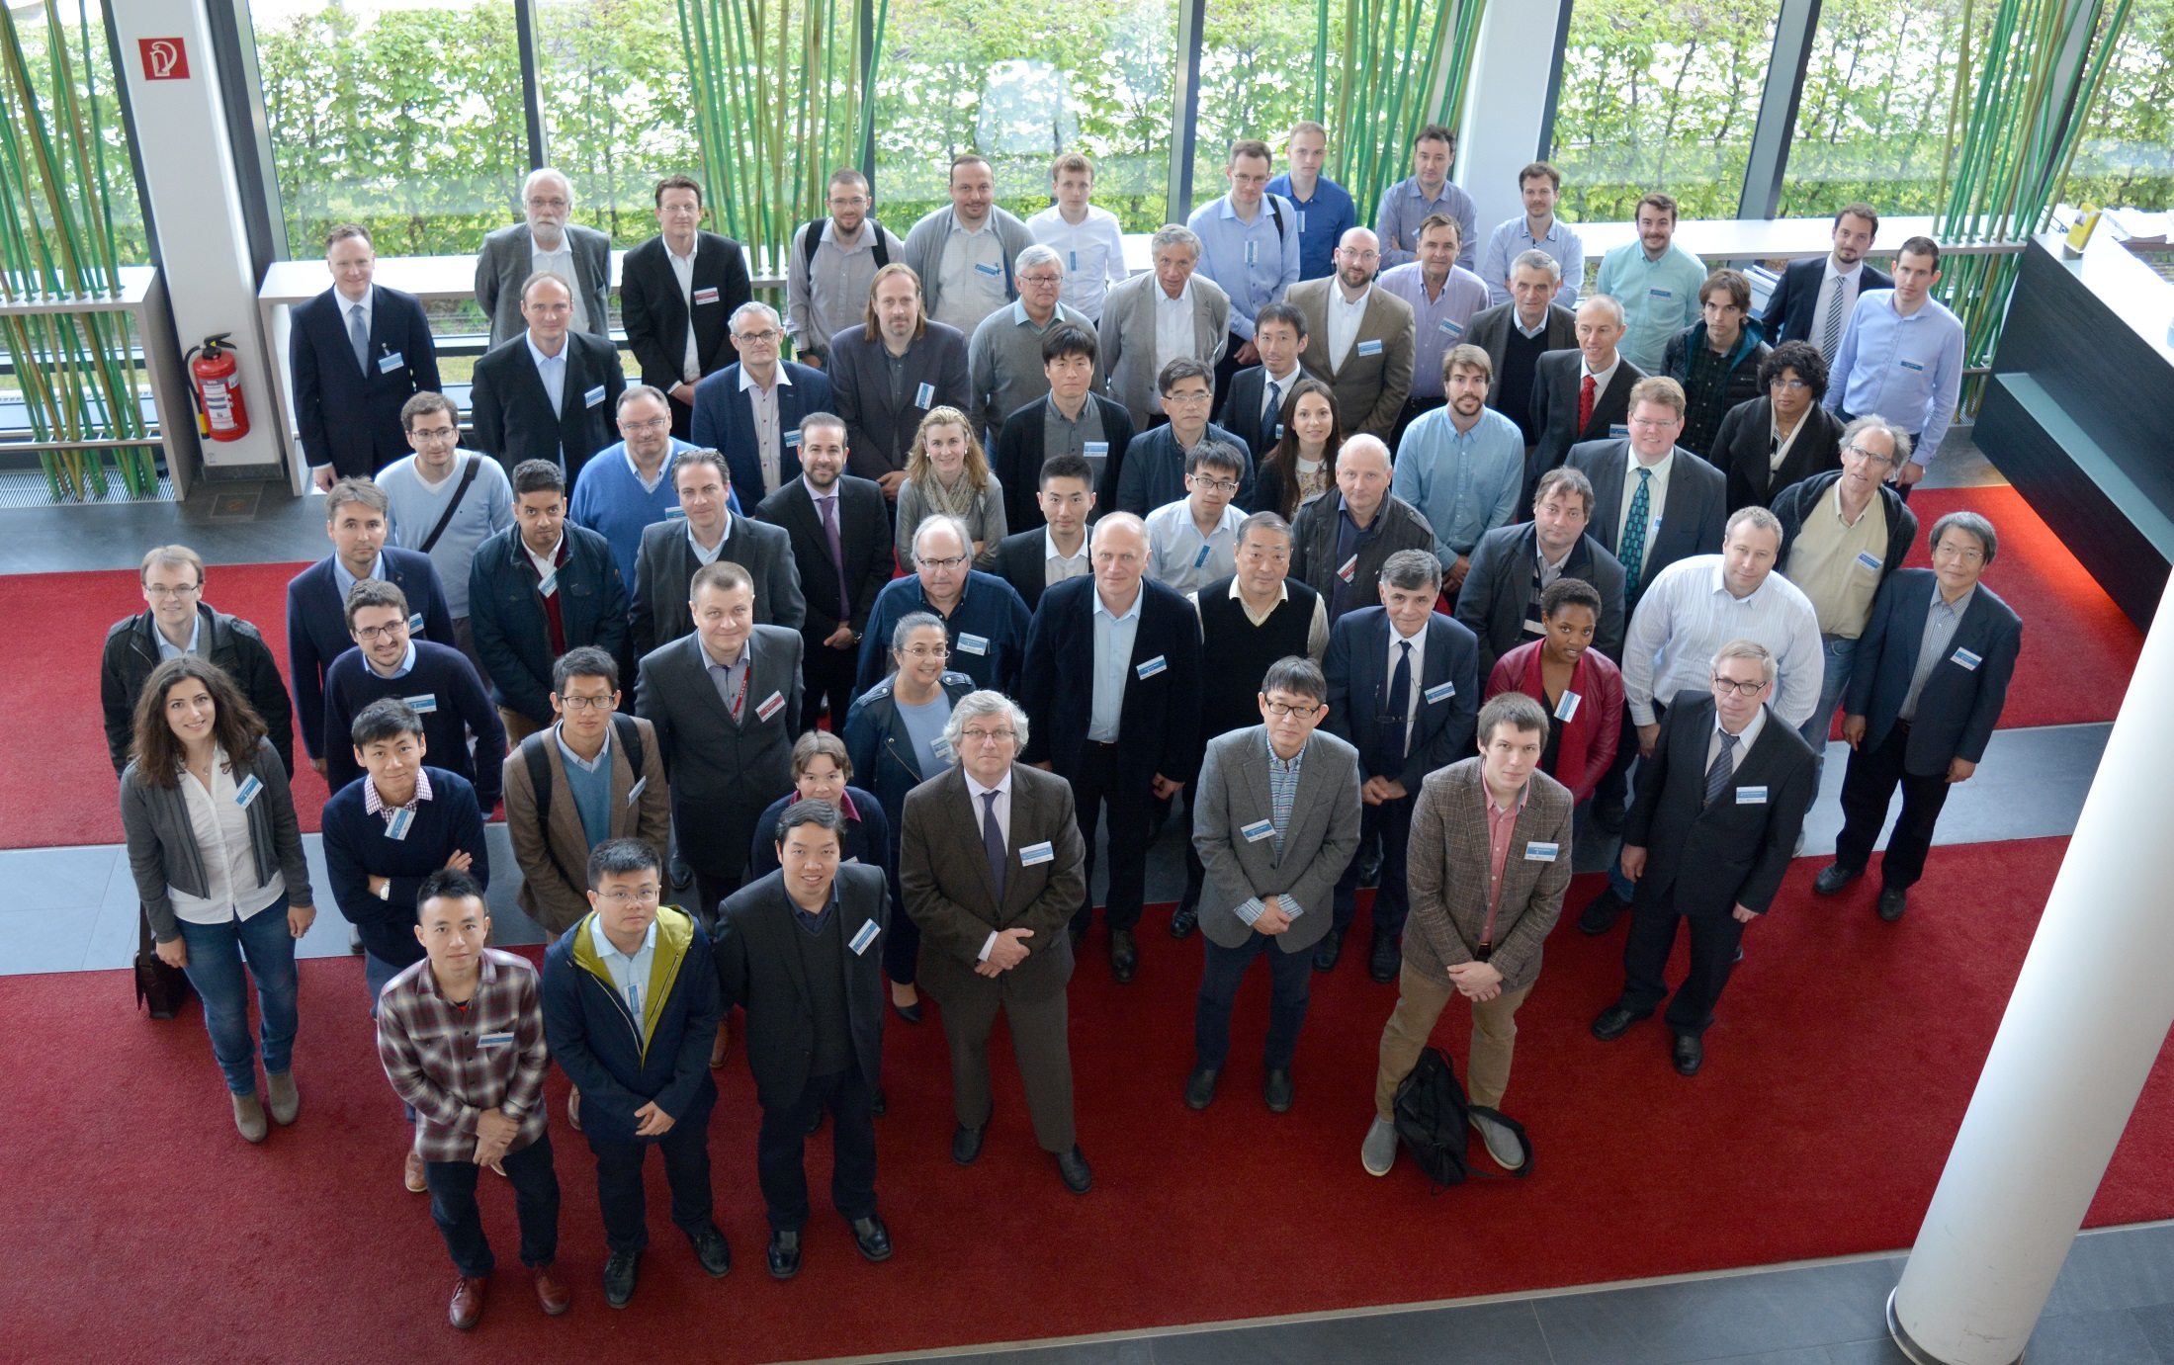
Eleventh OECD/NEA Light Water Reactor (LWR) Uncertainty Analysis in Modelling (UAM) benchmark workshop

Slide 7
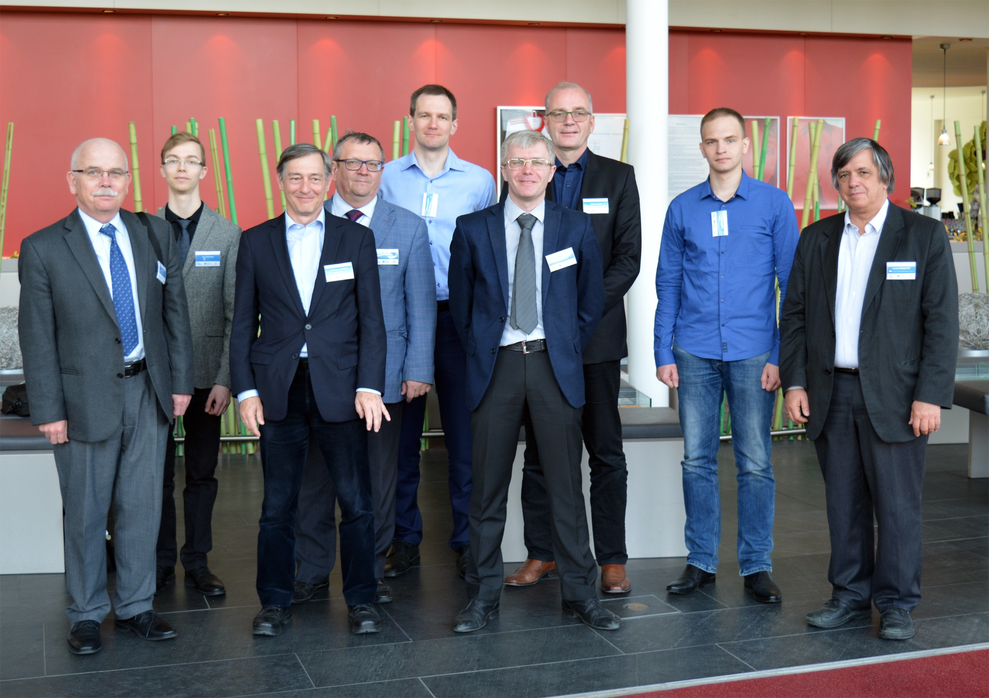
AER Working Group D meeting (VVER dynamics and safety)

